Slide 1
Synapse Development

Slide 2
Basics of Synapse Development

Slide 3
Platforms
Dedicated SQL pool
Serverless SQL pool
Spark pool
Data Explorer pool
Synapse Pipelines

Slide 4
SQL pools
Dedicated SQL pool
Query using T-SQL – supports the ‘normal’ syntax plus more
Provides Kimball-style data warehousing
Great for solving “known” business problems
Minimum data expectations: 1 TB of data, 1 billion rows in largest fact table
Serverless SQL pool
Query using T-SQL – supports a subset of the normal syntax
Access data lake data in an ad hoc fashion
Great for “spelunking”

Slide 5
Other Pools
Spark pool
Primary languages: Scala, Python, Java
Secondary languages: SQL, F#, C#
“Should be” language: R
Great for complex data transformation
Emphasizes procedural logic
Data Explorer pool
Kusto Query Language (KQL)
Great for log and event analysis

Slide 6
Synapse Pipelines
Based on Azure Data Factory code base
Works best for ELT, sometimes for ETL

Slide 7
Where Is My Data?
Dedicated SQL pool
Split into 60 distributions but can logically be considered together
Closest thing to a “normal” database for SQL Server users, though plenty of differences
Data Lake
Data files stored in Azure Data Lake Storage Gen2
Typically follows a particular hierarchical breakdown: Measure \ Year \ Month \ Day \ {Hour \ … }
Data typically stored in quasi-structured formats: CSV/delimited file, JSON, ORC, Parquet

Slide 8
Where Is My Data?
Lake Database
Data stored in a data lake
Metadata holds information on lake files and folders
Allows interoperation between Spark and serverless SQL pools
Spark views only available in Spark pools, not serverless SQL pool
Serverless SQL pool can read Spark external tables in Parquet, CSV, or Delta format—Delta format in public preview
Data Explorer pool
Unique storage engine opaque to end users
Data not stored in data lake and not available to other pools

Slide 9
So You Need to Develop Something
Notebooks
Quick and easy method for writing code
Can include code, documentation (via Markdown), images, and results in same file
Low-friction way to perform analysis and get things done
Code
Design and develop code-based solutions in IDEs
Execute using commands like spark-submit

Slide 10
So You Need to Develop Something
Why Notebooks?
Easy to create and maintain documentation: in line with the code
Supports multiple languages in the same notebook
Great for pedagogical purposes
Good interface in Synapse Studio
Why Code?
Do not need a separate notebook runner to execute
Easier to read code in other tools
Easier to compare in source control
Better for automating activities

Slide 11
So You Need to Develop Something
Why Not Both?
Notebooks can import and use custom-developed functions
Code can be based on notebooks
Synapse Pipelines can run both notebooks and code

Slide 12
Options for Deploying Code

Slide 13
Options
Pass around notebooks (.ipynb format)
Run Synapse pipelines
Deploy pipelines via Azure DevOps or GitHub YAML pipelines
Deploy code from source control using ADO or GitHub

Slide 14
Development in Python

Slide 15
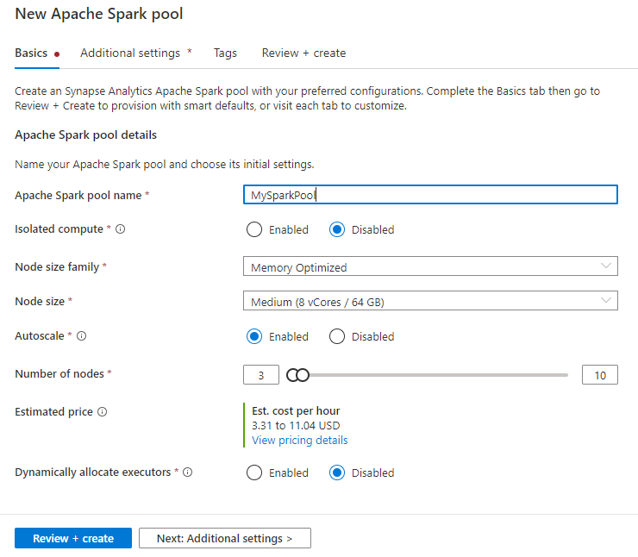
Start with a Spark pool
Node sizes
Node families
Node scaling
Isolated compute
Pausing and shutdown

Slide 16
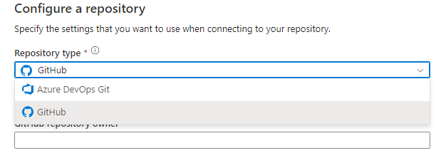
Connect to Source Control
Code must be in Git: GitHub or Azure DevOps
Store code assets
SQL scripts
KQL scripts
Notebooks
Data flows (Synapse Pipelines)
Spark job definitions

Slide 17
DEMO: Notebook

Slide 18
DEMO: Pipelines with Python

Slide 19
Secrets Management

Slide 20
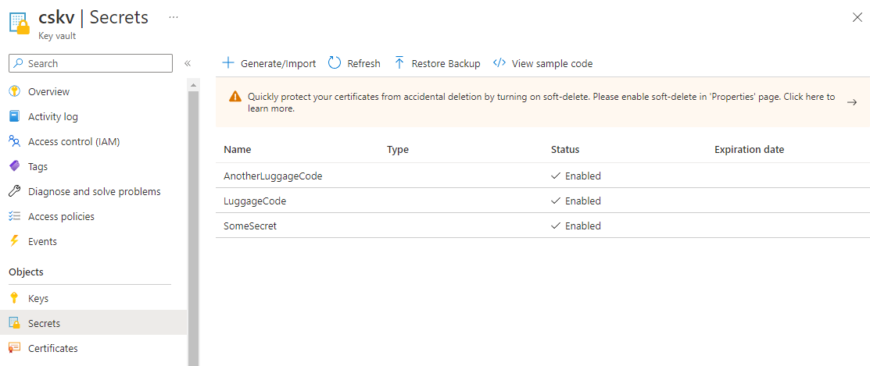
Key Vault
Azure service for secrets management
Securely store and manage keys, certs, other secrets

Slide 21
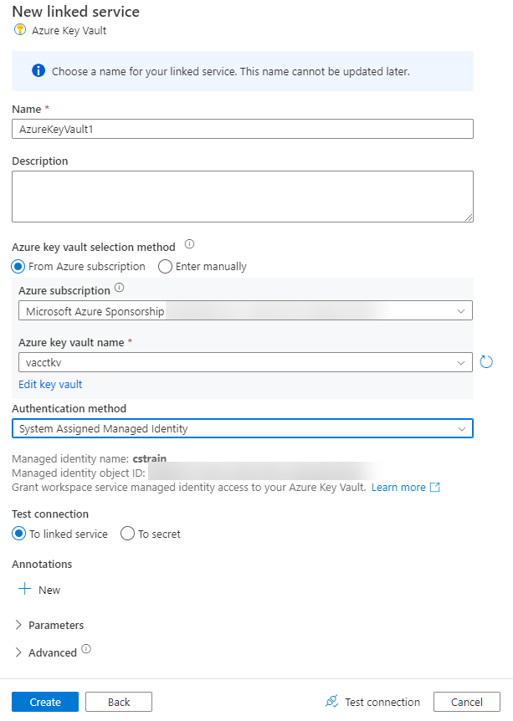
Connect to Key Vault
Create a linked service in Synapse
Connect using a managed identity—no service account passwords to update
Given certain circumstances, can ensure Key Vault traffic never leaves Azure networks

Slide 22
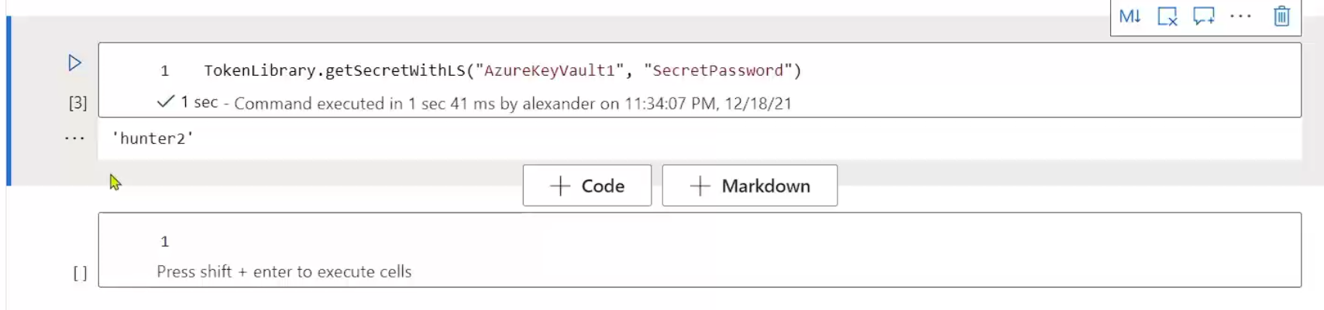
TokenLibrary
Library allowing you to query Key Vault from Spark pools
Prevent storing sensitive details in notebooks

Slide 23
Lab

Slide 24
Lab Part 1
Create a Spark pool
Import notebooks from source control
Build out a notebook
Try out basics of Python

Slide 25
Lab Part 2
Read data from the data lake
Process data with Python and Spark SQL
Perform basic machine learning with Python
Write results to the data lake

Slide 26
Lab Part 3
Convert notebook into Synapse pipeline
Execute notebook
Trigger on new data

Slide 27
Post-Lab Wrapup

Slide 28
What We Learned
Creating a Spark pool
Importing notebooks into a Synapse workspace
Running a Spark notebook
Building a simple ML model with PySpark
Writing prediction results to the data lake
Building a Synapse pipeline o execute a notebook

